Slide 1
Module and Packages
Program design ideas

Slide 2
Functions
Small functions, focused on one task
Defined input through arguments
Defined output with return variable or modification of object arguments
Minimize side effects, dependencies
Side effect = when a function modifies some state outside of the function, for example modifying a global variable, or printing data instead of returning it

Slide 3
Modules and Packages
https://realpython.com/python-modules-packages/

Slide 4
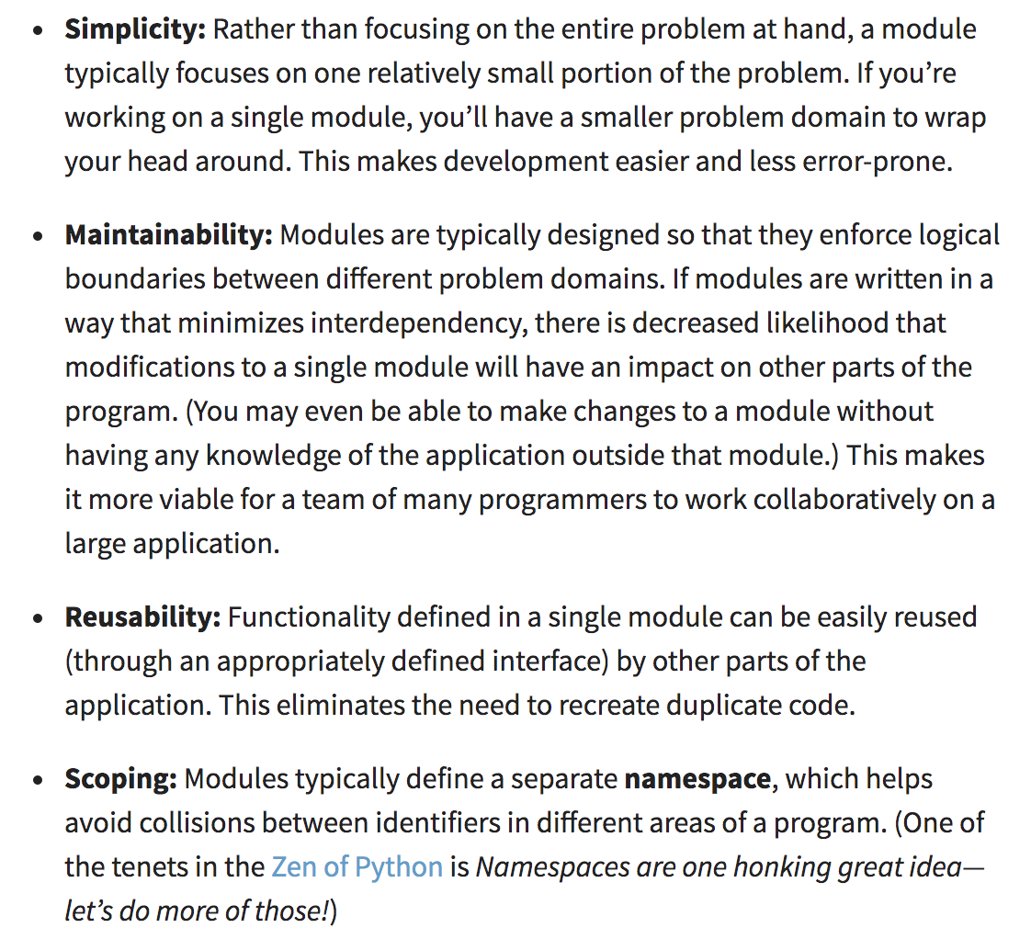
Benefits of modules
Benefits of functions, at a different scale
https://realpython.com/python-modules-packages/

Slide 5
Code
https://github.com/claraj/python_importing

Slide 6
Python modules
A module is a file with a .py extension
It can contain definitions: classes, variables, functions
It can contain statements: lines of code to run
When a module is imported into another module, the statements are executed
The classes, variables, and functions are available to the importing module

Slide 7
import main file
if __name__ == '__main__':
main()
__name__ is the module name when imported
__name___ is '__main__' when run from command prompt as a script

Slide 8
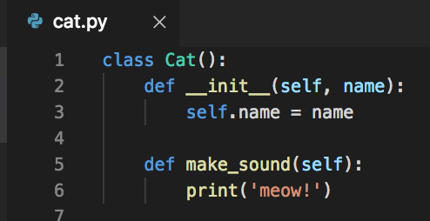
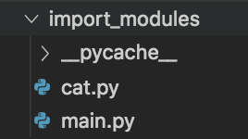
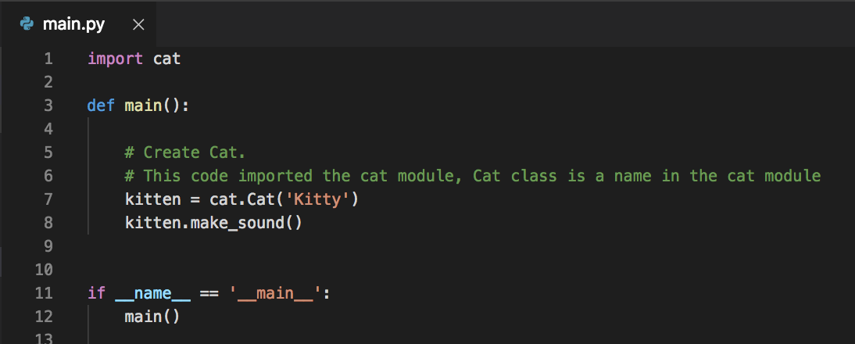
import module_name
Imports everything - classes, variables, functions, from the module with that name
Refer to a thing from the module with modulename.thing

Slide 9
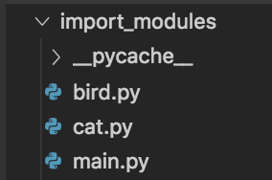
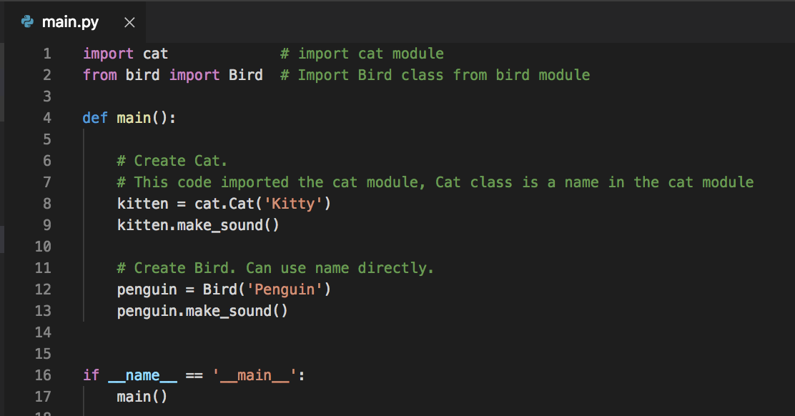
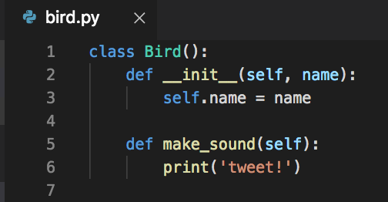
from module_name import name
Bird is available in code, Cat has to be referred to as cat.Cat

Slide 10
from module_name import *
Usually not recommended, brings all the names in, possible conflicts
OK if your code and you know you won't create any conflicts between names in your code and names in the module

Slide 11
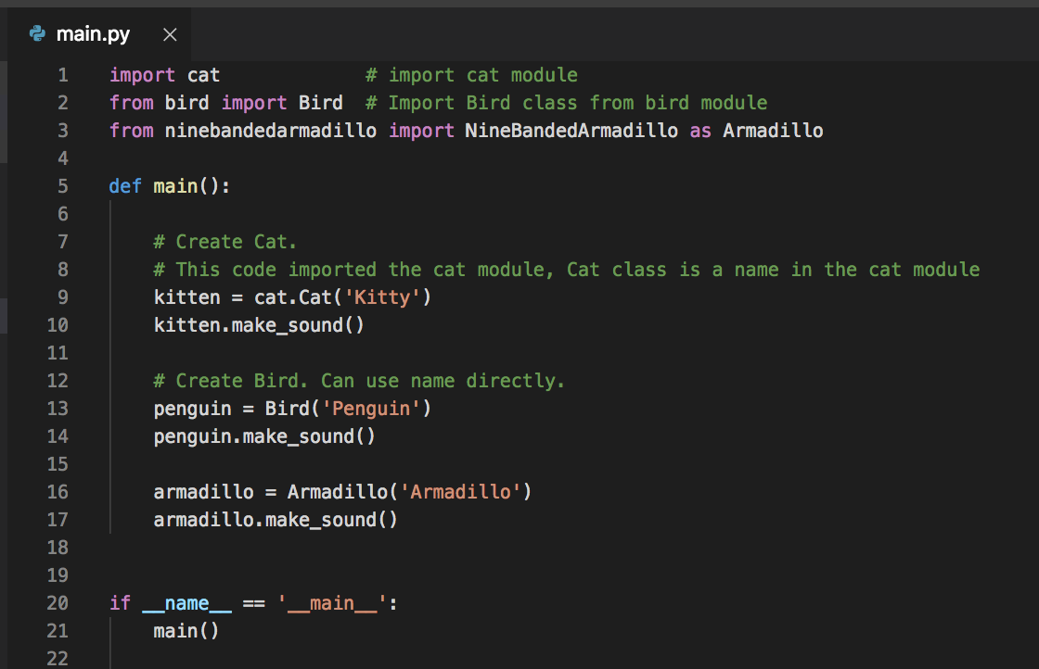
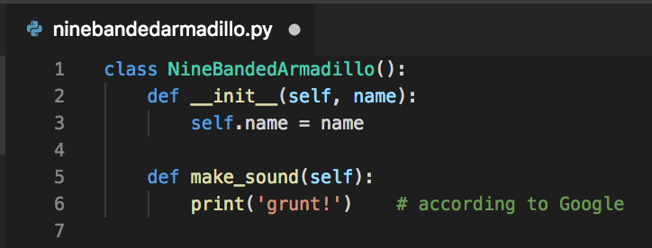
import module_name as mn from module_name import name as n
For long names, or names that might conflict with names that you would use in the module

Slide 12
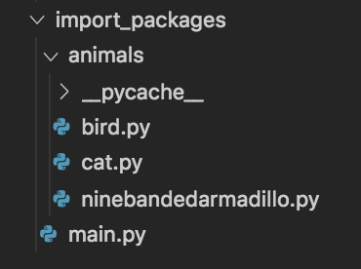
Python packages
One or more modules in a directory
Example: all the animals modules in a directory to create an animals package
Older python (3.6 and before) required a file called __init__.py in the directory, or imports wont work.

Slide 13
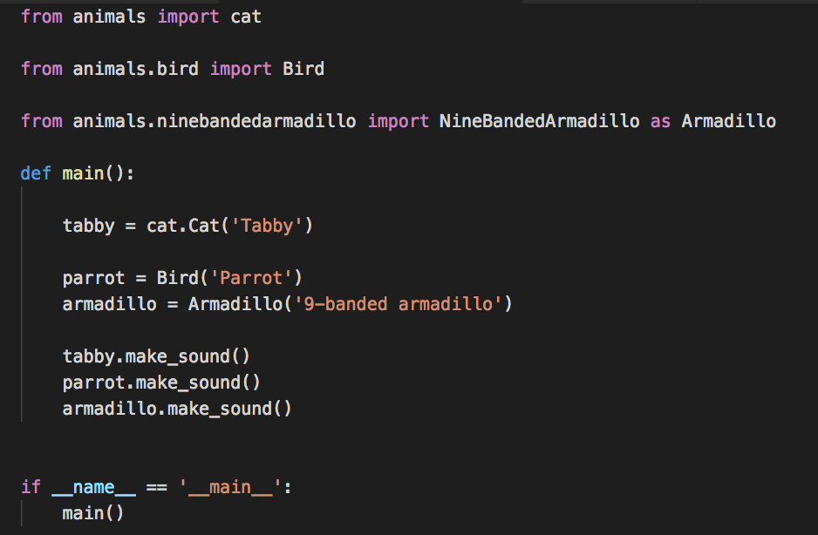
from package import module from package.module import name
Use dot notation to refer to modules within a package
Can use as to rename

Slide 14
SOLID - Object Oriented Design Principles
Single Responsibility Principle
Open/Closed Principle
Liskov Substitution Principle
Interface Segregation Principle
Dependency Inversion Principle
Python examples of all: https://github.com/heykarimoff/solid.python

Slide 15
Single-responsibility principle
Classes should have a single responsibility, or purpose
What does this module/class do? Can you describe it simply?
No? It may be too complex, consider breaking it down

Slide 16
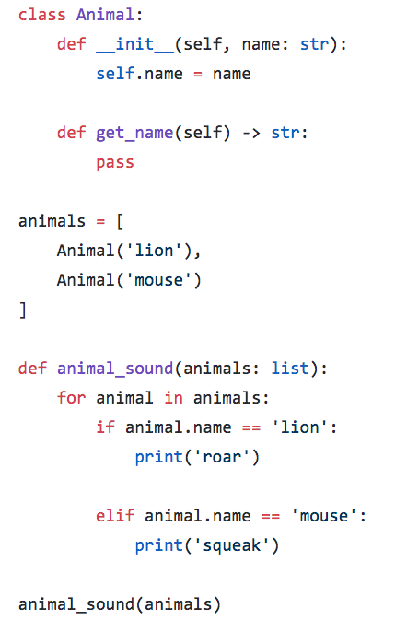
Open-closed principle
Closed to modification, open to extension
Once a class has a single responsibility, don't give it more responsibilities and behaviors
Create a base class, and subclasses instead
Encourage extension and re-use
https://github.com/heykarimoff/solid.python/blob/master/2.ocp.py

Slide 17
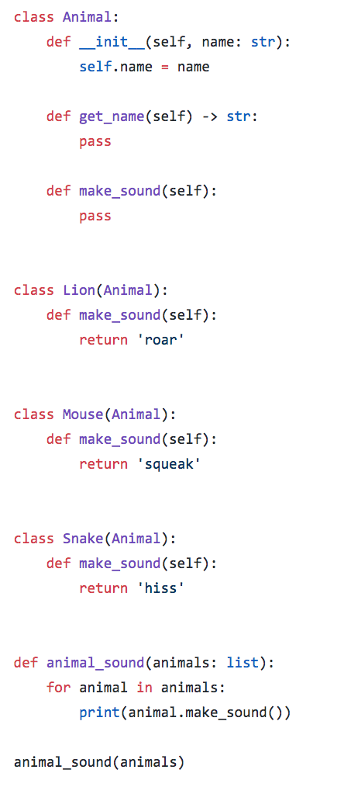
Open-closed principle
Better - one base Animal class
Subclass it and specialize
Each Animal provides it's own make_sound method
https://github.com/heykarimoff/solid.python/blob/master/2.ocp.py

Slide 18
Inheritance
Creating a new class that is an extension of a base class
Base class typically has essential functionality
Derived classes extend base, add features and/or customize behavior
Base class is often designed to be inherited from
Your unittests extending TestCase
Peewee models inheriting from Model

Slide 19
Liskov substitution principle
"Design by contract"
You should be able to replace a class with any of it's subclasses and it doesn't break anything in your code
In other words, extend functionality, don't modify core behavior
Example -
Activity subclasses in Android
Python test runner can run any TestCase subclass
Peewee can manage any subclass of Model without needing to do anything special or different with the subclass

Slide 20
Interface Segregation Principle
Avoid large, complex interfaces
Smaller, focused interfaces are better
Related to Single Responsibility Principle

Slide 21
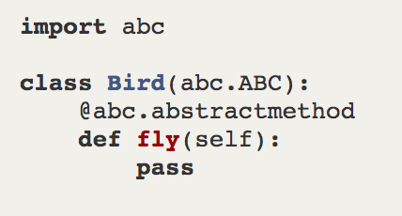
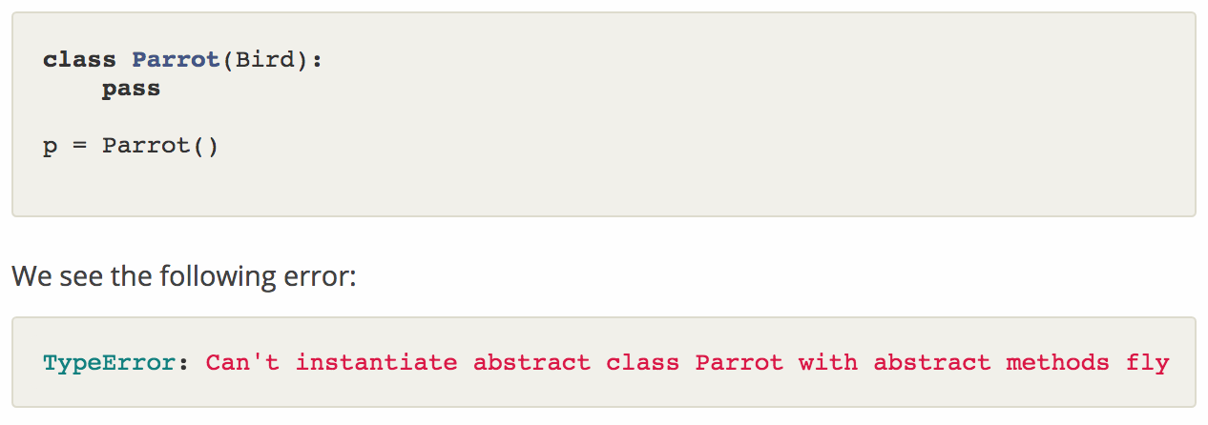
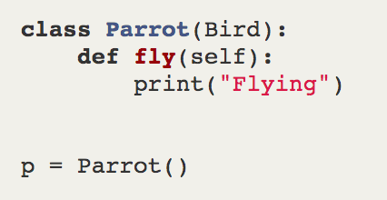
Interfaces - In Python, implemented with ABC
Abstract Base Classes
Any subclasses must provide the abstract methods defined
Errors - Parrot class has no fly method
This works
http://masnun.rocks/2017/04/15/interfaces-in-python-protocols-and-abcs/

Slide 22
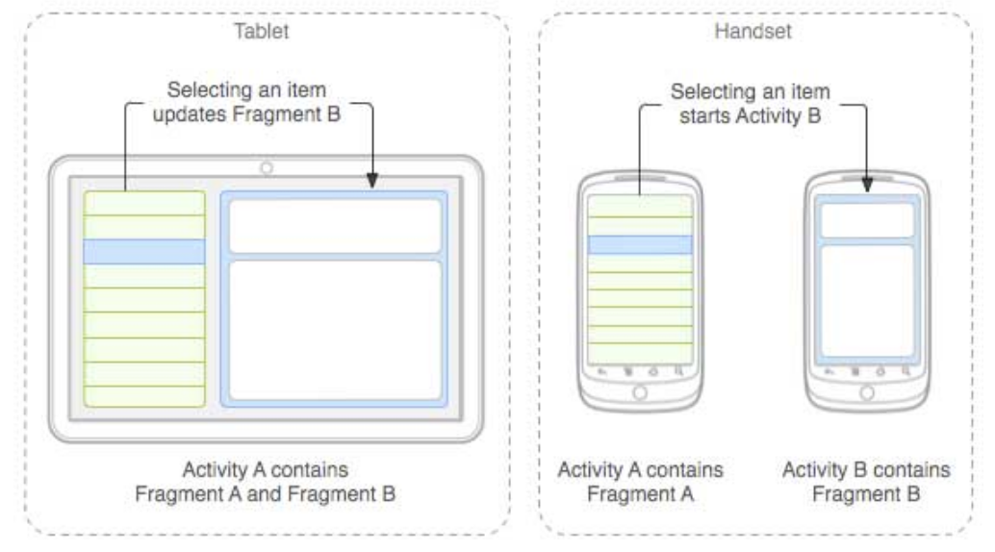
Interfaces: describe the behaviors a class must provide
When two classes communicate, can use an interface to describe what methods must be provided
Example in Android: one Fragment of the UI may need to communicate with it's container. But a Fragment should be a modular, independent, reusable thing - so it should not need to depend on what exactly it's container is
Solution: describe an interface with methods that the Fragment expects to call in it's container
Container will implement these methods
Fragment is guaranteed to be able to call methods in container
In Java and C#, the compiler can verify

Slide 23
Dependency Inversion Principle
A dependency is any object that another object requires
Minimizing dependencies is good - don't define everything a class needs inside it
Think about what may need to be swapped out or changed
To account for future requirement changes
While the program is being developed
While the program is being tested
"Dependency should be on abstractions not concretions
High-level modules should not depend upon low-level modules. Both should depend upon abstractions.
Abstractions should not depend on details. Details should depend upon abstractions."

Slide 24
"Dependency should be on abstractions not concretions "
A class should depend on having a database of some kind (abstract)
But it shouldn't have to care about what specific database (concrete)
So SQLite could be swapped out for MySQL or data on a remote server accessed by API and the class wouldn't be affected
To apply this principle, pass dependencies into modules/objects as they are created, instead of having the module create it's own
Makes modification easier
Another advantage - when testing, easier to provide a fake version of the dependency

Slide 25
Dependency Inversion Principle
AKA Inversion of Control
While testing, replacing a dependency (for example, swap out a database for a mock) is called dependency Injection
Providing dependencies to classes makes classes more independent and reusable
Replacing a dependency in Python is easy
In Java/C#, more work is needed hence dependency injection libraries
https://www.vogella.com/tutorials/DependencyInjection/article.html
https://github.com/google/guice/wiki/Motivation
https://docs.microsoft.com/en-us/aspnet/core/fundamentals/dependency-injection?view=aspnetcore-3.0

Slide 26
Refactor milesdb program with SOLID principles
The requirements have changed too - we need to store the type of vehicle, as well as it's name
And to display all of the vehicles in the DB
https://github.com/claraj/miles_solid

Slide 27
Single Responsibility Principle
Even though this program doesn't have many features, it has several things it does
Interacting with the user - getting input, printing output
Configuring and managing a database
Dealing with errors
And usually more features will be required
So break down into modules, each with specific role

Slide 28
Modules
Vehicle
Main
View Utils
View
MileageError
main has high-level config, sets up View, ViewModel and SQLDatabase
View deals with user interaction, details delegated to ViewUtil
ViewModel handles communication between View and Database
VehicleDB is an abstract class, defining what methods the database must provide
SQLDatabase contains database interaction
Vehicle represents one Vehicle entity in the program
MileageError represents errors
ViewModel
VehicleDB
ABC
miles.db
SQLite
SQLDatabase

Slide 29
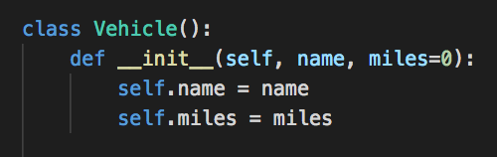
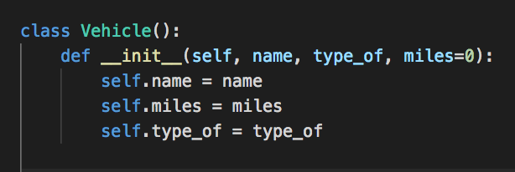
Open for Extension, Closed For Modification
What if the program needs to manage Cars, Vans, Motorcycles differently?
Current Vehicle class
type_of would be 'Car', 'Van' etc.
What's wrong with doing this?

Slide 30
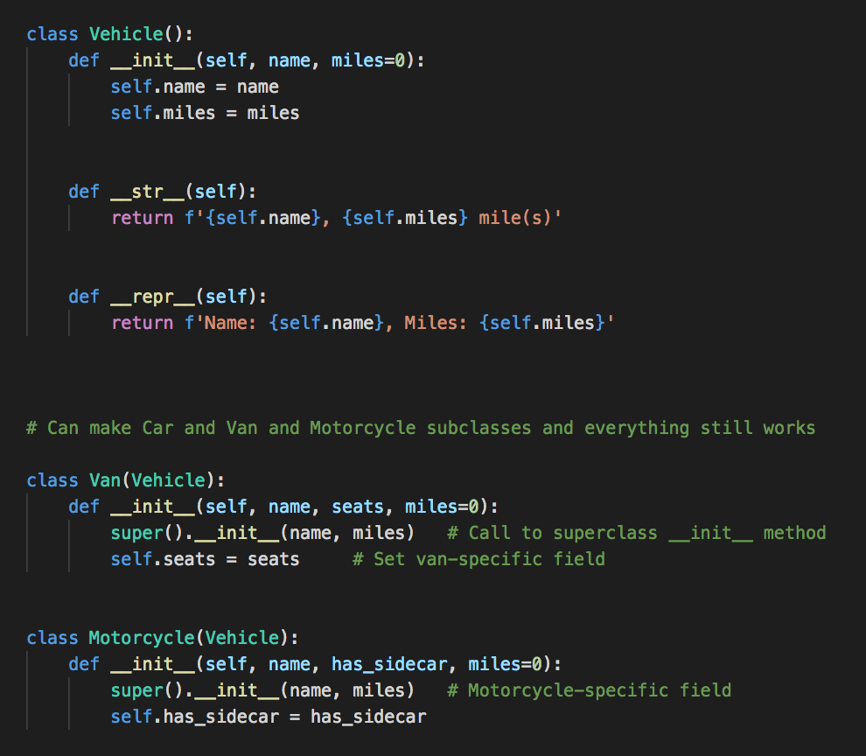
model.py
Specializing Vehicle with subclasses
Add Van-specific behavior
Or, Motorcycle-specific behavior

Slide 31
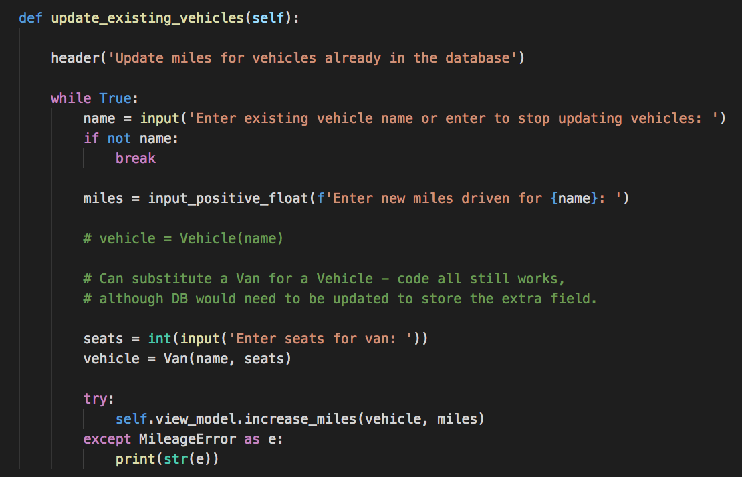
Liskov substitution principle
This works with no modifications to the code
The DB would need to be modified to add new field, but the code is happy

Slide 32
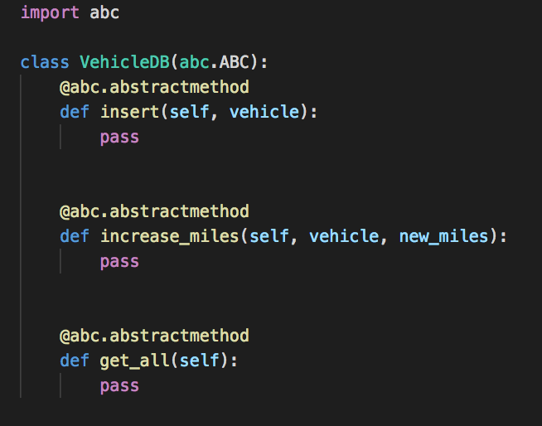
Interface Segregation Principle
Where is an interface used in the code?
Python uses Abstract Basic Classes to implement interfaces
VehicleABC
Anything that inherits from this class must provide insert, increase_miles and get_all methods

Slide 33
What if we want to replace SQL with an API?
Vehicle
Main
View Utils
View
Create a new class APIDatabase that extends VehicleDB and provides the same methods
Can simply swap the classes - rest of program doesn't care as long as something provides the required behavior
VehicleDB
ABC
ViewModel
miles.db
SQLite
SQLDatabase
APIDatabase
API Server

Slide 34
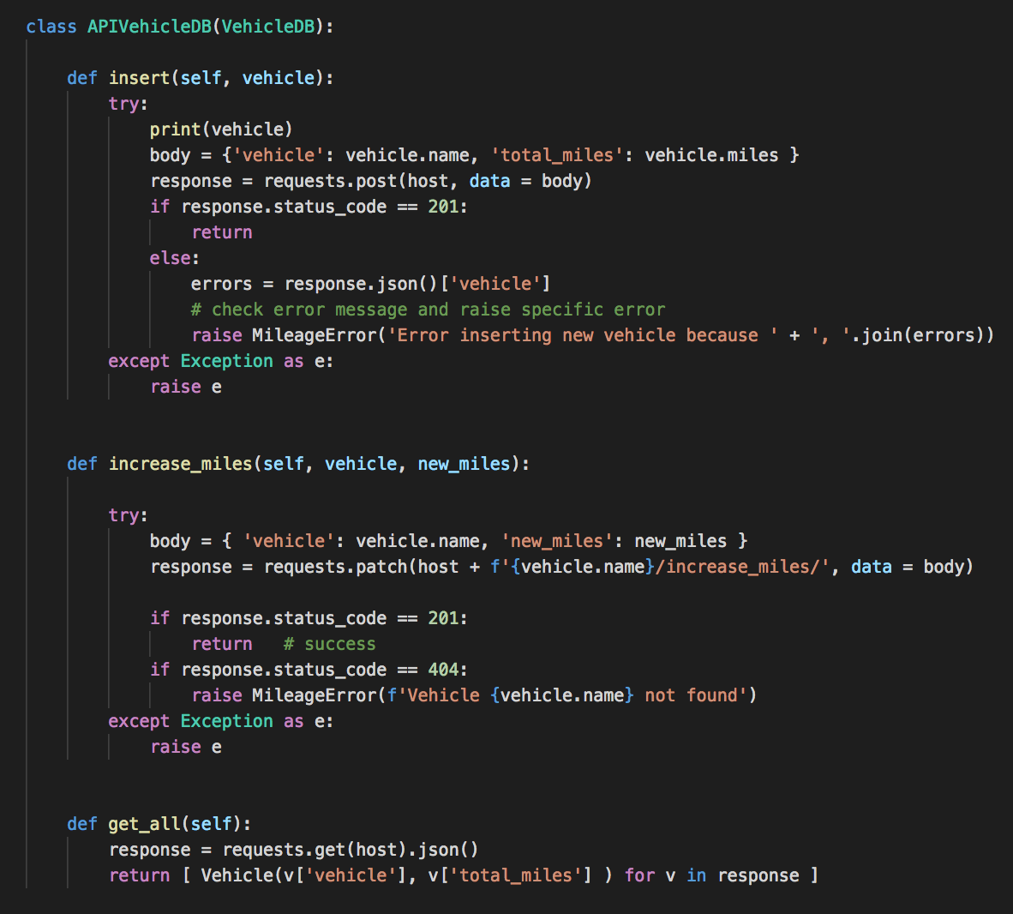
Same interface as SQLDatabase
Methods work in very different way, but as long as the data is saved as expected, the rest of the code doesn't care how or where it is saved

Slide 35
Interface Segregation Principle
Interfaces should be focused - create a specific set of method(s) in your ABC

Slide 36
Dependency Inversion Principle
View is given a ViewModel to use
ViewModel is given a Database to use
SQLDatabase reads configuration info from a separate file
Makes it easier to test View - provide a mock ViewModel
Makes it easier to test ViewModel - provide a mock database

Slide 37
Project 3 - How does this apply
How well does your code conform to the single responsibility principle?
Do you have separate modules and functions?
Will your code be easy to test?
Lab: think about these questions, work on refactoring your project

